Slide 1

American International University Bangladesh (AIub)
Faculty Of Science and Technology
ENGINEERING ETHICS
Section : C
Group : 2 (The Moral Metrics)
Spring 2024-25
Supervised By:
BISHWAJIT BANIK PATHIK
NAME | ID
MD ABDUL AZIZ | 22-47013-1
AZAZ MOHAMMAD KAIF | 22-48795-3
BEDANTA SAHA | 22-47152-1
BIDHAN SAHA | 22-47153-1
MOHAMMAD RAFSAN YEASIR | 22-46065-1

Slide 2

TABLE OF CONTENT
CASE STUDY
Institution of Engineers, Bangladesh (IEB) Code of Ethics
Key IEB ethics that were violated
Ethical dilemmas
Four Step Ethical Dilemma Analysis
Conclusion
Reference

Slide 3
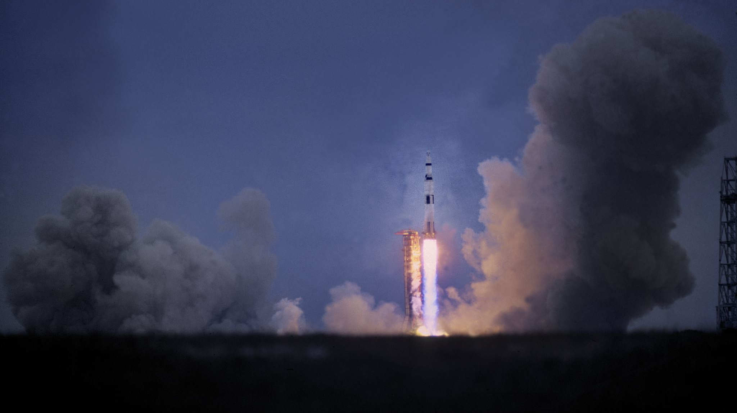

CASe study
On January 28, 1986, NASA’s space shuttle Challenger broke apart 73 seconds after launch, killing all seven crew members, including a civilian teacher . The disaster was caused by the failure of an O-ring seal in the right solid rocket booster due to unusually cold weather . Engineers from Morton Thiokol, the contractor for the booster, had warned NASA that the O-rings could fail in such cold temperatures. They initially recommended delaying the launch, but under pressure from NASA to stay on schedule, managers overruled the engineers and approved the launch . A subsequent investigation by the Rogers Commission found that the tragedy resulted not just from technical failure, but from poor decision-making, ignored safety warnings, and ethical lapses. The case remains a powerful example of the consequences of prioritizing deadlines over safety and the need for engineers to uphold their ethical responsibility to protect lives.
Microsoft Power Point Stock Images

Slide 4
Institution of Engineers, Bangladesh (IEB) Code of Ethics
What is IEB Ethics?
IEB Ethics is a guideline for professional conduct that ensures
engineers:
Act honestly and responsibly
Prioritize public safety, health, and welfare
Maintain integrity and fairness
Avoid conflict of interest
Respect confidentiality
Practice only within their area of competence
Why is IEB Ethics Necessary?
Public Safety Engineers design structures, machines, and systems that affect lives. Ethics ensure they prioritize safety over personal or commercial interests.
Professional Integrity Ethics build trust between engineers and society. It ensures engineers don't compromise quality or cut corners.
Accountability A code of ethics provides a standard to judge professional misconduct and hold individuals accountable.
Environmental and Social Responsibility Engineers often work on large-scale projects that affect the environment and communities. Ethics guide them to be socially and environmentally conscious.
Reputation of the Profession When engineers follow ethical guidelines, it upholds the reputation and credibility of the engineering profession in the country.
Legal and Regulatory Compliance Ethics often align with national laws and regulations, helping engineers avoid legal issues.

Slide 5
Key Ieb ethics that were violated
Responsibility to the Public
"Engineers shall hold paramount the safety, health, and welfare of the public.“
Violated: The engineers and managers allowed the launch to proceed despite knowing there was a serious safety risk with the O-rings in cold weather. The public and the astronauts were not adequately protected.
2. Honesty and Integrity
"Engineers shall be honest and impartial, and shall serve with fidelity the public, their employers, and clients.“
Violated: Some managers at Morton Thiokol reversed their engineers' decision under pressure, and critical concerns were not communicated clearly or forcefully enough to NASA leadership.
3. Professional Judgment
"Engineers shall perform services only in areas of their competence and shall issue public statements only in an objective and truthful manner.“
Violated: NASA’s decision-makers were not fully informed about the seriousness of the engineers’ concerns. The technical risks were downplayed during the final decision-making process.

Slide 6
Key Ieb ethics that were violated
4. Duty to Report Danger
"Engineers shall advise their superiors when they believe a project will not be successful.“
Violated: Although some engineers did warn of danger, the final decision did not reflect those warnings. There was no strong escalation or whistleblowing, even though lives were at stake.
5. Loyalty to the Profession
"Engineers shall uphold the honor and dignity of the profession.“
Violated: Allowing management and political pressure to override technical facts compromised engineering integrity and brought negative attention to the profession.

Slide 7

Ethical dilemmas
Safety vs. Schedule Pressure
Engineers at Morton Thiokol recognized a serious risk with the O-rings due to the cold weather.
Despite this, NASA was under immense pressure to maintain its launch schedule due to political, media, and funding reasons.
Managers were faced with the decision to delay the launch to ensure safety or proceed to avoid organizational consequences.
The ethical question: Should safety always override deadlines, even under intense external pressure?

Slide 8
Ethical dilemmas
Professional Integrity vs. Corporate Loyalty
Morton Thiokol managers initially supported delaying the launch based on technical advice.
Under pressure from NASA, they reversed their decision, prioritizing their client relationship over engineering integrity.
This created a conflict between doing what was ethically right and pleasing a powerful client.
The ethical question: Should engineers and companies compromise on ethics to protect business relationships?

Slide 9
ETHICAL DIlemmas
Speaking Up vs. Staying Silent
Engineers, particularly Roger Boisjoly, voiced strong concerns about the O-rings.
However, when their warnings were dismissed, they did not escalate the issue further to stop the launch.
They were placed in a situation where raising objections could risk their careers but staying silent risked lives.
The ethical question: : Should an engineer risk their job to prevent a disaster, or stay silent when overruled by management?

Slide 10
Ethical Dilemma Analysis:
Moral Clarity:
What is the ethical dilemma?
Engineers at Morton Thiokol discovered that the O-rings were likely to fail at low temperatures, posing a severe risk to the shuttle and its crew. NASA was eager to proceed with the launch due to political and public pressures.
The dilemma : Should the engineers and managers delay the launch to ensure safety, or proceed to meet NASA’s expectations and avoid conflict?

Slide 11
Ethical Dilemma Analysis:
2. Know the Facts: What are the relevant details?
The O-rings had previously shown signs of failure in cold weather.
The temperature on the morning of the launch was well below recommended limits.
Engineers initially recommended a delay, but Thiokol management reversed the decision under NASA pressure.
The shuttle launched on January 28, 1986, and exploded 73 seconds into flight, killing all seven astronauts.

Slide 12
Ethical Dilemma Analysis:
3. Consider the Options: What actions could be taken?
Option 1: Stand firm on delaying the launch based on safety data, even at the cost of friction with NASA or losing the contract.
Option 2: Escalate the issue to higher NASA officials or external oversight bodies.
Option 3: Proceed with the launch as pressured, while documenting the disagreement and hoping for the best (which is what happened).
Option 4: Go public or involve a third-party safety review to delay the launch.

Slide 13
Ethical Dilemma Analysis:
4. Make a Reasonable Decision: What is the most ethical course of action?
The ethical and professional decision would have been to delay the launch until safety was assured.
If management failed to act responsibly, engineers had a duty to increase concerns, even if it risked their jobs.
Prioritizing human life and ethical responsibility over schedule and organizational loyalty should have guided all decisions.
Final Judgment: The Challenger disaster could have been avoided if ethical decision-making had been followed. Engineers must always act to protect public safety, even under intense pressure.

Slide 14
Conclusion
The Challenger disaster occurred on January 28, 1986, when the shuttle
exploded shortly after launch, killing seven astronauts. The cause was O
ring failure due to cold weather, a risk that engineers had warned about.
The fault lies with NASA and Morton Thiokol management, who ignored
safety concerns under schedule pressure.
Ethical principles broken include:
Public safety
Professional integrity
Accountability
Key ethical dilemmas:
Safety vs. Schedule
Speaking Up vs. Staying Silent
Integrity vs. Loyalty
To prevent the tragedy, the launch should have been delayed, and engineers' concerns taken seriously. This case highlights the need to always prioritize ethics and safety over deadlines or pressure.

Slide 15

reference
1. https://www.nasa.gov/history/the-crew-of-the-space-shuttle-challenger-sts-51l-mission/
2. https://www.britannica.com/event/Challenger-disaster
3. https://www.history.com/articles/challenger-disaster
Microsoft Power Point Stock Images

